Slide 1
Will China be the Next Superpower?
Wendy Pooley
Why should we care?
Abbey Child
Bryson Taggart

Slide 2
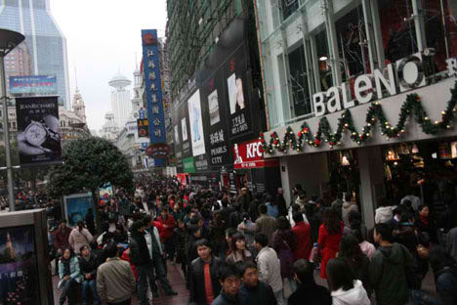
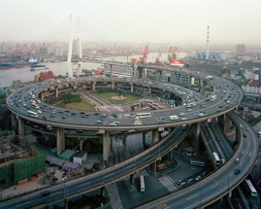
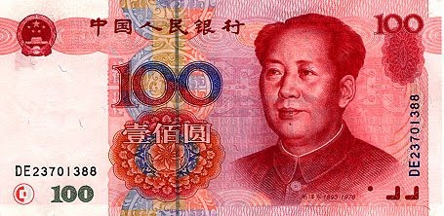
Introduction
2nd largest economy
2nd largest importer of goods
Largest exporter
3 things preventing them

Slide 3
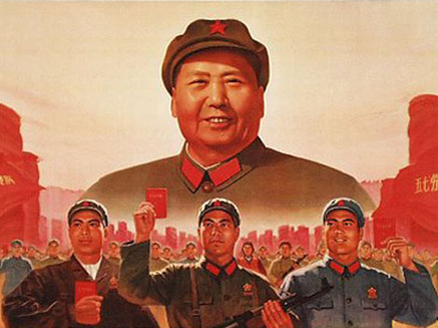
Communism
Need freedom
Internet
Religion

Slide 4
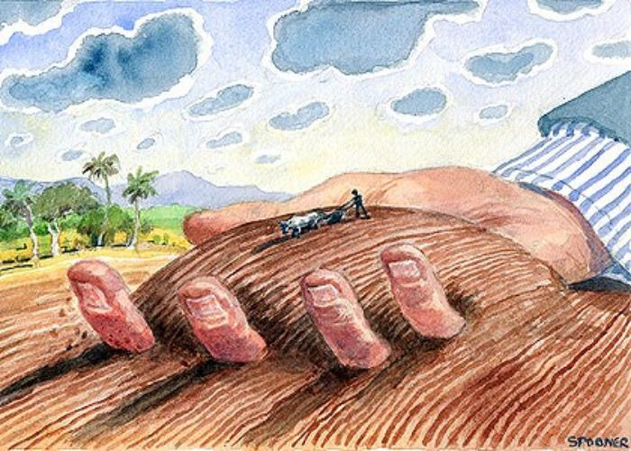
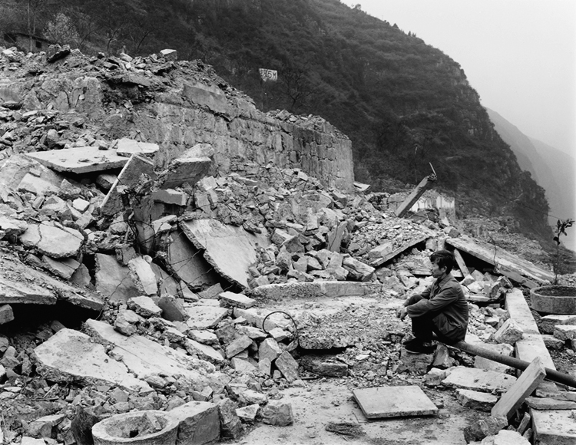
Corruption
Piracy
Abortion
Land grabs

Slide 5
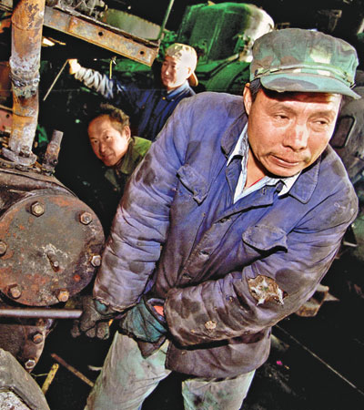
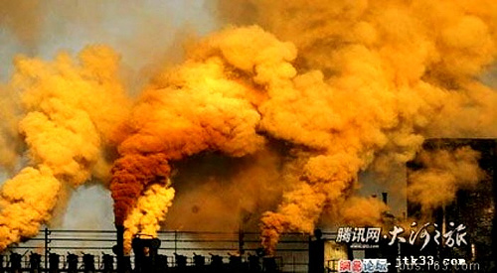
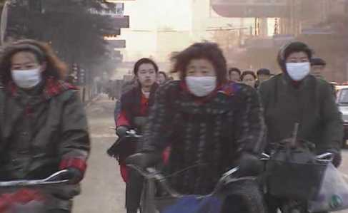
The Needs of the People
Pollution
Working conditions

Slide 6
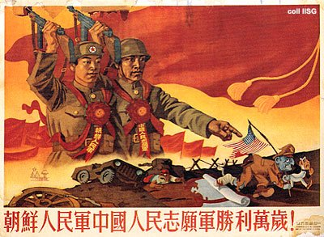
Conclusion
Why care?
Communist country
Competition for jobs
*China has the potential of becoming the next superpower, but there are many issues that prevent them from achieving this.

Slide 7
Works Cited
http://en.wikipedia.org/wiki/Economy_of_the_People's_Republic_of_China
http://www.rationalrevolution.net/war/maoist_china.htm
http://en.wikipedia.org/wiki/Demographics_of_the_People%27s_Republic_of_China
http://humanrightshouse.org/Articles/17806.html
http://io9.com/5948528/the-unintended-consequences-of-chinas-one+child-policy
http://blogs.wsj.com/chinarealtime/2012/09/25/working-conditions-the-persistence-of-problems-in-chinas-factories/
http://www.guardian.co.uk/world/gallery/2012/mar/29/tibet-exiles-protest-india
http://blog.miragestudio7.com/the-bund-and-shanghai-architecture/3076/
http://www.pcmag.com/slideshow/story/266213/life-behind-the-great-firewall-of-china
http://shardsofchina.wordpress.com/tag/average-wage/

