Slide 1
Habitats

Slide 2
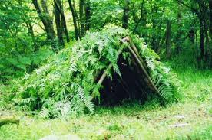
What is a Habitat?
A place where an animal finds:

Slide 3
4 Different Land Habitats
Desert
Rain Forest
Woodland Forest
Arctic

Slide 4
Water Habitats

Slide 5
Desert
Little Rain
Only few kinds of plants and animals live here
Plants and animals that live here don’t need much water

Slide 6
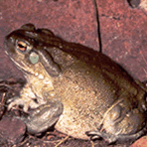
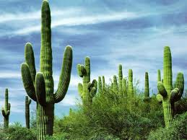
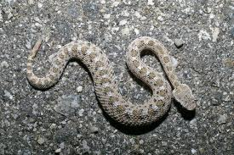
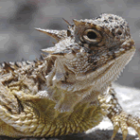
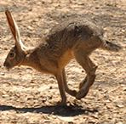
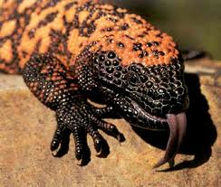

Slide 7
Rain Forest
Rain falls almost every day
Warm weather all year
Many plants and animals live here

Slide 8
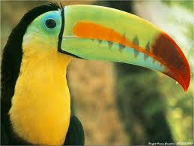
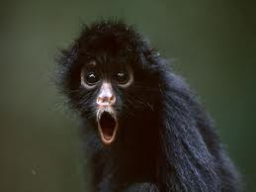
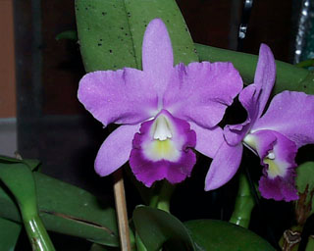
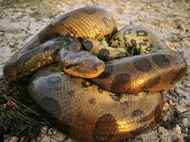
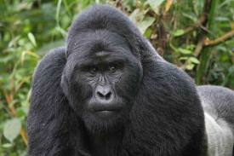

Slide 9
Woodland Forest
There is both rain and warmth
Many trees
It has four seasons

Slide 10
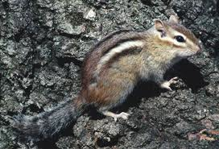
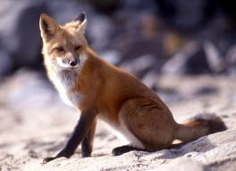
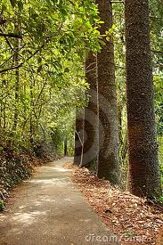
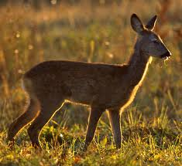
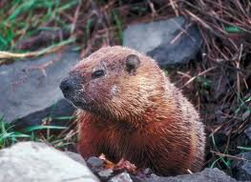

Slide 11
Arctic
Cold and windy
Covered with ice and snow most of the year
Short summers
Small number of animals and plants live here

Slide 12
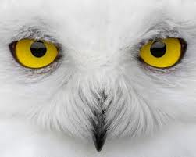
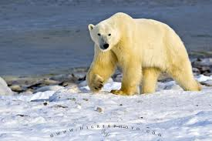
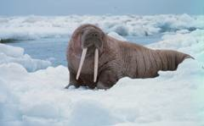
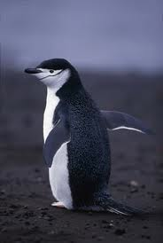
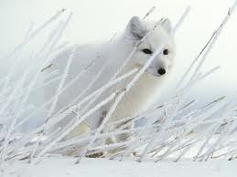

Slide 13
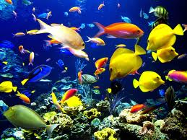
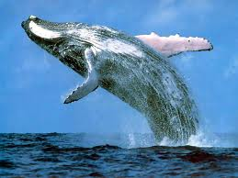
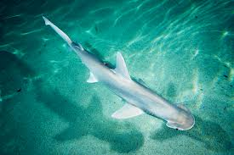
WATER HABITATS

Slide 14
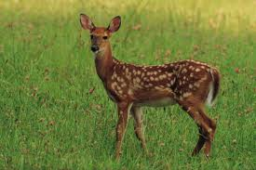
Desert Rainforest
Woodland Forest Arctic
Water

Slide 15
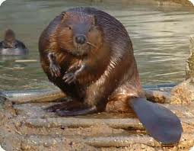
Desert Rainforest
Woodland Forest Arctic
Water

Slide 16
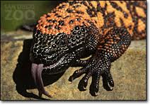
Desert Rainforest
Woodland Forest Arctic
Water

Slide 17
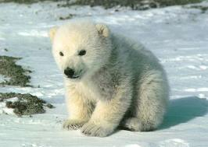
Desert Rainforest
Woodland Forest Arctic
Water

Slide 18
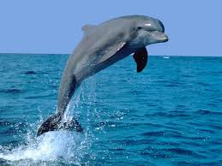
Desert Rainforest
Woodland Forest Arctic
Water

Slide 19
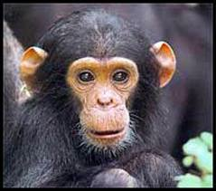
Desert Rainforest
Woodland Forest Arctic
Water

Slide 20
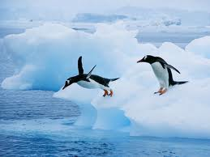
Desert Rainforest
Woodland Forest Arctic
Water

Slide 21
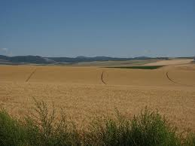
Rexburg Idaho?

